Slide 1
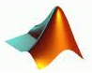




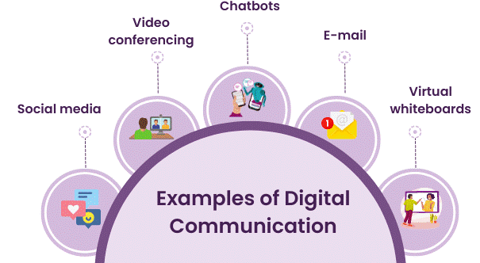
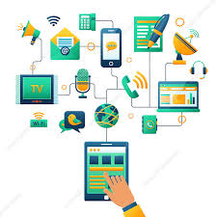

DIGITAL COMMUNICATIONS
Course Code: 23EC2208A
Dr. G V Subbarao
Department of Electronics and Communications Engineering
K L E F Deemed to be University

Slide 2
SYLLABUS
Pulse Modulation Techniques: Baseband signals. Sampling process; Concepts on PAM, PWM and PPM. Quantization Process; Quantization Noise; Linear and Non-linear PCM codes, Noise Considerations in PCM Systems; PCM Line Speed, DPCM, Delta Modulation (DM) and Adaptive DM. Line codes.
Transmission Through Bandlimited Channels: Line Coding; Characterization of Band limited Channels, Optimum Receiver for the AWGN Channel, Detection of Baseband Signals in Noise, Matched filter, Other binary signal transmission and antipodal signals., The Power Spectrum of a Digital PAM Signal, Inter symbol Interference: Eye diagrams, System Design for Band limited Channels. Raised Cosine spectrum, Linear and non-linear Equalizers.
Digital Transmission via Carrier Modulation: Concepts on measure of Information: Bits, Bit Rate, Baud, and M-ary Encoding; Noiseless coding-Huffman coding, Channel capacity, ASK, PSK, FSK, QAM. Bandwidth Efficiency, Carrier and Clock Recovery, Probability of Error and Bit Error Rate, Error Performance.
Spread Spectrum Modulation: Pseudo-noise sequences, notion of spread spectrum, Direct Sequence Spread Spectrum (DSSS) with coherent BPSK, Signal space, dimensionality and processing gain, Probability error and Frequency-Hop Spread Spectrum.

Slide 3
Communication Channels and Their Characteristics
(Content Prepared by Dr. M. Venugopala Rao, CC)

Slide 4
Introduction to Communication Channels
An electronic communication channel is a medium that allows the transmission of information from one place to another.
Electronic communication channels can be used to transmit data, voice, and video signals. A few physical channels are illustrated below:
Wireline channels: Twisted-pair wirelines and coaxial cable are basically guided electro-magnetic channels.
They provide relatively modest bandwidths of several hundred kilohertz (kHz) twisted wire and few MHz .for coaxial cable.
Signals transmitted through such channels are distorted in both amplitude and phase, and they are further corrupted by additive noise.
Twisted-pair wireline channels are also prone to crosstalk interference from physically adjacent channels.

Slide 5
Wireless Electromagnetic Channels.
In radio communication systems, electromagnetic energy is coupled to the propagation medium by an antenna, which serves as the radiator.
A long wave radio channel occupies up to 1 MHz
A short-wave radio channel occupies up to 100 MHz
A Microwave wave radio channel that includes Experimental Navigation, Satellite to satellite, Microwave relay, Earth-satellite, Radar, wireless LANs and cellular communications occupies up to 100 GHz
Storage Channels:
The process of storing data on a magnetic tape, magnetic disk, or optical disk is equivalent to transmitting a signal over a telephone or a radio channel.
The readback process and the signal processing used to recover the stored information is equivalent to the functions performed by a telephone receiver or radio communication system to recover the transmitted information.

Slide 6
Mathematical Models for Communication Channels
While designing communication systems to transmit information through physical channels,
we find it convenient to construct mathematical models that reflect the most important characteristics of the transmission medium.
Then the mathematical model for the channel is used in the design of the channel encoder and modulator at the transmitter and the demodulator and channel decoder at the receiver.

Slide 7
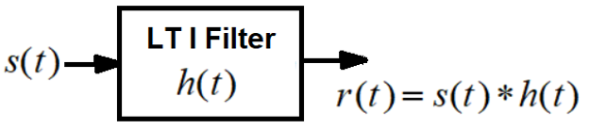
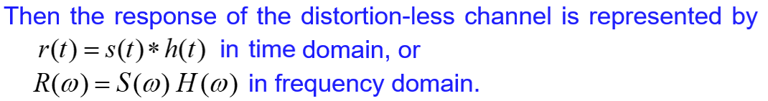
Ideal channel (Distortion-less Transmission)

Slide 8
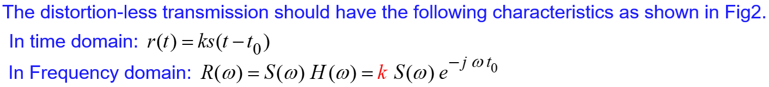
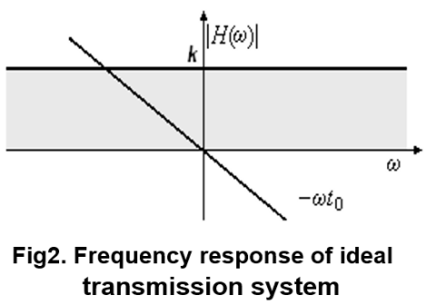
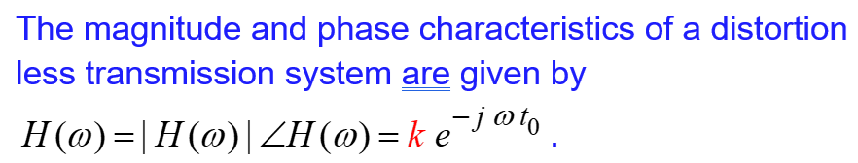
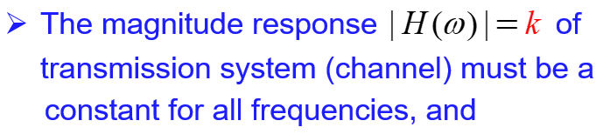
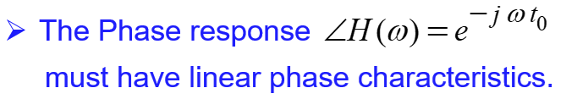

Slide 9
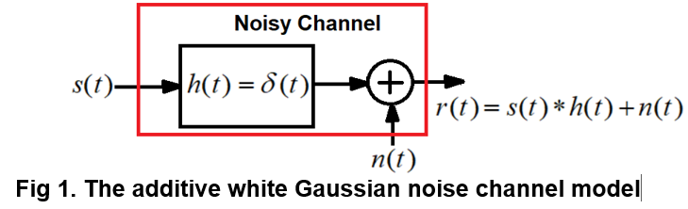
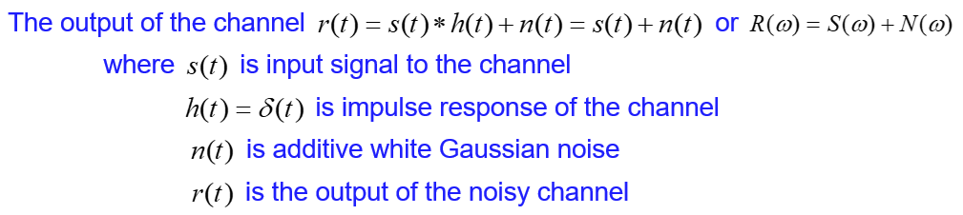
The Additive White Gaussian Noise (AWGN) Channel

Slide 10
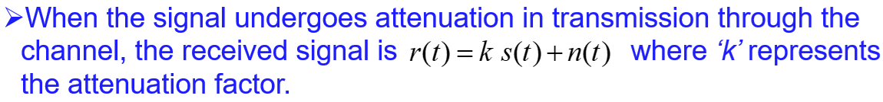
AWGN is often used as a channel model in which the only impairment to communication is a linear addition of wideband or white noise with
a constant spectral density (watts per Hertz), and
Gaussian distribution of amplitude.
The model does not account for fading, frequency selectivity, interference, non-linearity or dispersion. Hence the impulse response of channel is delta function.

Slide 11
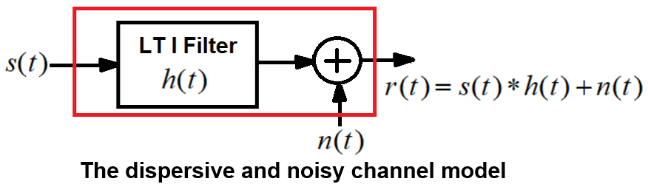
Dispersive and Noisy Channel
A dispersive channel refers to a type of communication channel where
signals, particularly high-frequency signals, experience distortion due to low bandwidth of the channel and
varying propagation delays for different frequency components.

Slide 12
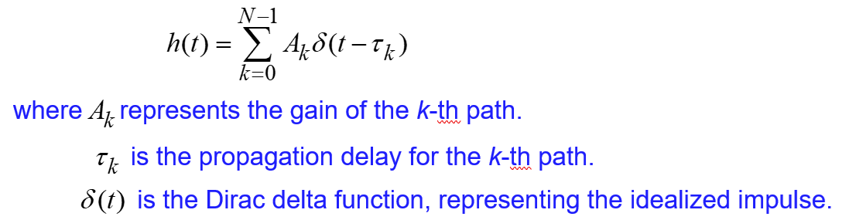
Channel Impulse Response: The channel can be characterized by an impulse response h(t), which captures the way the channel affects the transmitted signal.
A dispersive channel’s impulse response is often a function of time and can be modelled as:

Slide 13

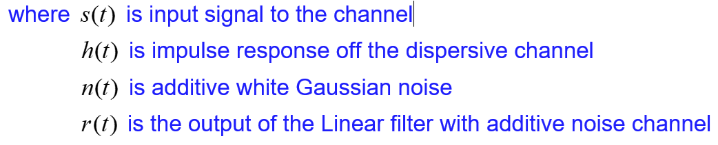
This kind of channel is usually encountered in wireless communication systems, broadband communications, and other systems where wideband signals are transmitted.
The dispersive nature of the channel causes inter-symbol interference (ISI), which can degrade the performance of the communication system unless it is properly compensated for.

Slide 14
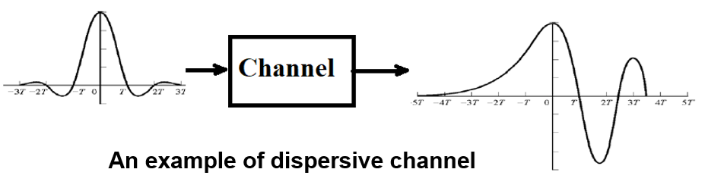

Slide 15
Detection of Baseband Signals in Noise, Optimum Receiver, Matched Filter

